Slide 1
SWE-500 Software Engineering
E-Appointment System

Slide 2
E-Appointment System
  Presented By:
    Sangeeta Joshi
    Ekta Khiani
    Shravani Edem
    Nilam Patil
    Shweta Sahu
    Abdul Sattar
2711 North First St. - San Jose, CA 95134 - www.itu.edu

Slide 3
Project Concept
The goal of this project is to develop efficient system for scheduling appointment online for a university.
Project features include:
  Scheduling appointments online 24*7
  Easy access of faculty availability for making an appointment.
  Setting up your appointment availability online.
  Automating the system to expedite the appointment process.
  Creation of all types of users
2711 North First St. - San Jose, CA 95134 - www.itu.edu

Slide 4
Problem Statement
The system is developed to upgrade the manual system into computerized system minimizing data loss and data redundancy
The system provides the ease of scheduling appointment online.
The authentication process of online system will allow only right people to access right data and change it accordingly.
2711 North First St. - San Jose, CA 95134 - www.itu.edu

Slide 5
Target User’s
Prospect Students
Current Students
Staff ( ISO, Faculty, Academic Advisors, Admission Advisors)
Admin
2711 North First St. - San Jose, CA 95134 - www.itu.edu

Slide 6
Requirements
Functional | Non Functional
Schedule appointment online for any prospect student without logging into the system. Schedule appointment online (Access to all the faculty and staff) Set up appointment availability Add, update and delete users with different role as Admin Email confirmation | Safety & Security Usability Performance Reliability Software and hardware constraint
2711 North First St. - San Jose, CA 95134 - www.itu.edu

Slide 7
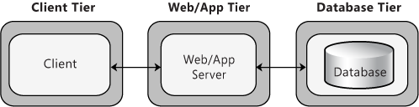
Architecture Diagram
2711 North First St. - San Jose, CA 95134 - www.itu.edu

Slide 8
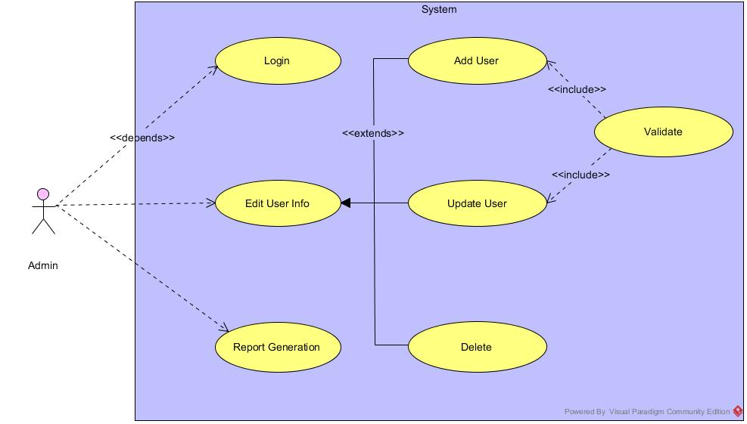
Admin Use Case
2711 North First St. - San Jose, CA 95134 - www.itu.edu

Slide 9
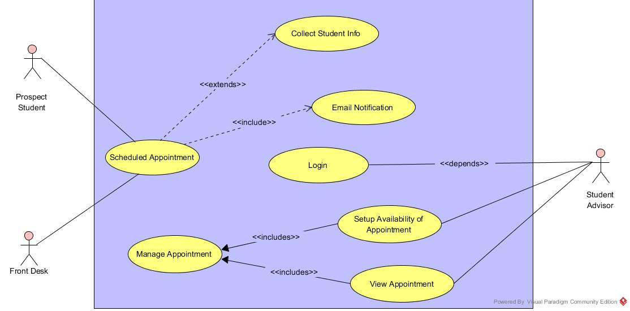
Prospect Student Use Case
2711 North First St. - San Jose, CA 95134 - www.itu.edu

Slide 10

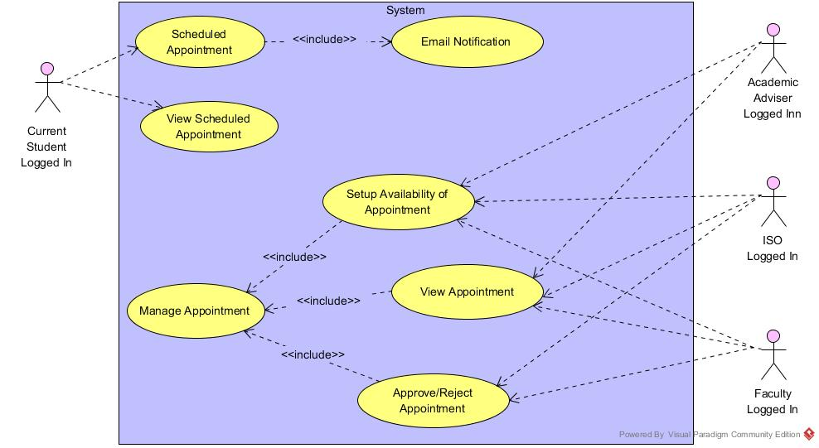
Current Student Use Case
2711 North First St. - San Jose, CA 95134 - www.itu.edu

Slide 11
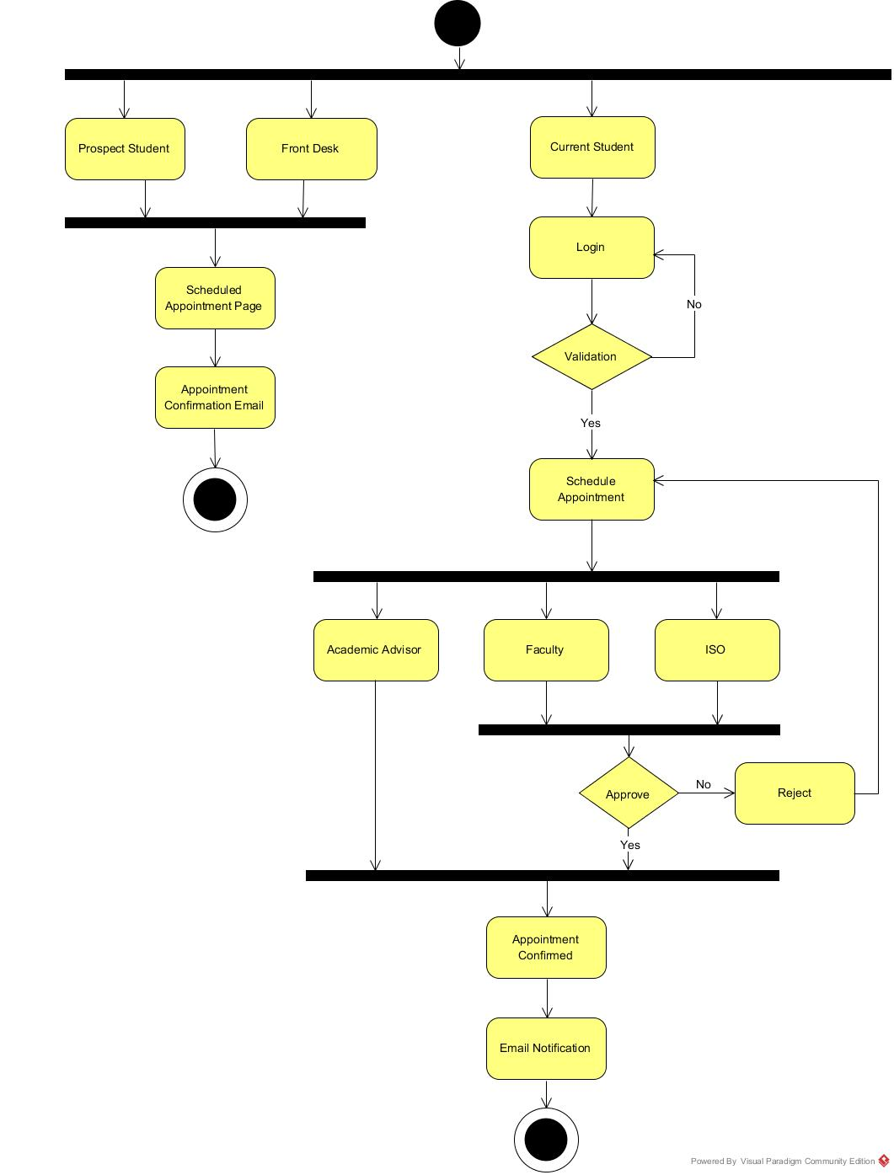
Activity Diagram
2711 North First St. - San Jose, CA 95134 - www.itu.edu

Slide 12
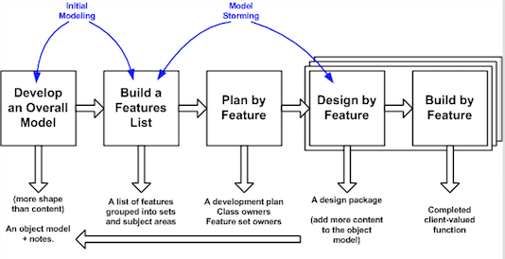
Software Model
Feature Driven Development (Agile)
  Agile iterative development methodology
  Based on breaking down the requirements into small client-valued pieces of functionality
2711 North First St. - San Jose, CA 95134 - www.itu.edu

Slide 13
E-Appointment Demo
2711 North First St. - San Jose, CA 95134 - www.itu.edu

Slide 14
Demo Flow
Login with Admin Credentials.
  Create a New User of type Faculty.
Login as newly created Faculty User.
  Create Appointment Setup.
Login as ITU Student.
  Schedule an Appointment with Faculty.
2711 North First St. - San Jose, CA 95134 - www.itu.edu

Slide 15
Demo Flow (Cont.)
Login as Faculty.
  Approve/Reject Appointment.
Login as ITU Student.
  Schedule an Appointment with Academic Advisor.
Prospect Student.
  Schedule an Appointment with Student Advisor.
2711 North First St. - San Jose, CA 95134 - www.itu.edu

Slide 16
Software Testing
What is testing ?
  Execution of an application with intent of finding the software bugs.
Significance:
  Meets business and technical requirements guiding an applications’ design and development.
  Points out defects and errors made during the development phases
  Reduces failures in future occurring at customer site (credibility risk)
  Improves product quality and performance corresponding to increased customer’s reliability and their satisfaction

Slide 17
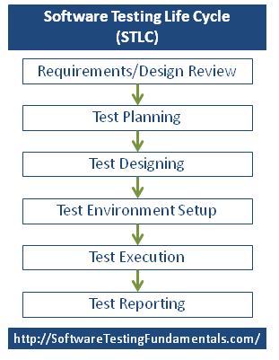
Software Testing Life Cycle
Review software requirements
Start planning for the tests (estimate/schedule)
Detail test cases based on requirements
Replicate end user's environment
Execute test cases/scripts
Prepare test reports and publish

Slide 18
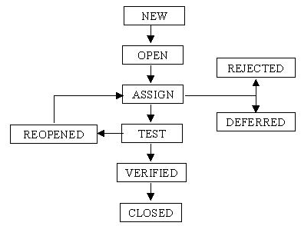
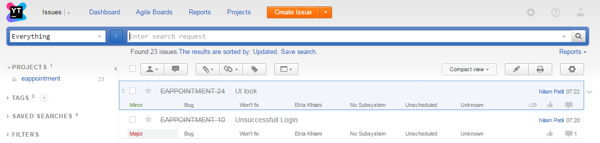
Software Bug
Software bug is an error, flaw, failure or fault in an application that causes it to produce an incorrect or unexpected result, or to behave in unintended ways.
YouTrack Bug Reporting
https://itueappointment.myjetbrains.com/
Software bug Life Cycle
2711 North First St. - San Jose, CA 95134 - www.itu.edu

Slide 19
Types of Testing
Acceptance Testing
Alpha and Beta Testing
Black Box Testing
Regression Testing
UAT (User Acceptance testing)
Performance Testing
Automated Testing
Notes:
Acceptance Testing: Formal testing with respect to user needs, requirements, and business processes conducted to determine the acceptability of the system.
Alpha and Beta Testing: Alpha testing is the testing done by test teams at development site after the acceptance testing. Beta testing carried out by real users in real environment.
Black Box Testing: Black box testing is the testing technique whereby the internal workings of the item being tested are not known by the tester.
Automated Testing: Using automation tools to write and execute test cases is known as automation testing.
Regression testing means rerunning test cases from existing test suites to build confidence that software changes have no unintended side-effects.
UAT (User Acceptance testing): It is performed by the end users of the software. This testing happens in the final phase of testing.
Performance Testing: The goal of application performance testing is to appraise any user experience in realistic scenarios on our target application. In software engineering, performance testing is in general testing performed to determine how a system performs in terms of responsiveness and stability under every condition.

Slide 20
Manual Testing
Manual testing software for defects
Tester plays the role of an end user and uses most of all features of the application to ensure correct behavior.
To ensure completeness of testing, the tester follows a written test plan that leads them through a set of important test cases.
Demonstrate Manual Test Case of
Login Screen
2711 North First St. - San Jose, CA 95134 - www.itu.edu

Slide 21
Automated Testing
A process in which software tools execute pre-scripted tests on a software application
Can be carried out with tools such as Selenium repeatedly
Selenium: An open-source and a portable automated software testing tool for testing web applications.
Selenium IDE:
  An easy-to-use Firefox plug-in to develop Selenium test cases.
  Provides a Graphical User Interface (GUI) for recording user actions
  Executes tests within the browser, so focus is NOT required while script execution is in progress
  Limitation: Can only be used with Firefox browser
Notes:
However, the recorded scripts can be converted into various programming languages supported by Selenium and the scripts can be executed on other browsers as well.

Slide 22
Selenium Demo
AutomationTest Suite Flow:
  Admin creates account for a current student “Ming Gu”;
  Admin edits mobile number of student “Andrei Ei”;
  Faculty “Soni Saha” sets up her appointment slots;
  Student “Ming Gu” takes an appointment with faculty “Soni Saha” for project discussion;
  Faculty “Soni Saha” receives email notification and approves the appointment;
  Student “Ming Gu” receives email notification and views the confirmation; and
  Prospective student “Mike Crane” schedules an appointment with the student advisor “Trishna Saha” regarding admission.
Selenium IDE Demo of E-Appointment Portal

Slide 23
Challenges
Challenges | Mitigation
The project teammates took some unplanned leaves. Faced challenges in installing the required software and server for development and testing in teammates machines. Web app development and Selenium automation testing was new, so had to spend more time to learn and do . | Had to put more effort and speed up the development for 1 sprint. By meeting online and on campus and spent extensive hours. By spending extra hours in learning and doing.
2711 North First St. - San Jose, CA 95134 - www.itu.edu

Slide 24
Lessons Learnt
Objectives:
Gathering requirements, designing of different UML diagrams.
Work distribution and management in a team along with client co-ordination
Documentations and its importance
Co-ordination and synchronization amongst team members.
Be flexible and open to change.
Importance of software testing and Quality assurance.
2711 North First St. - San Jose, CA 95134 - www.itu.edu

Slide 25
Thank you
2711 North First St. - San Jose, CA 95134 - www.itu.edu

